Slide 1
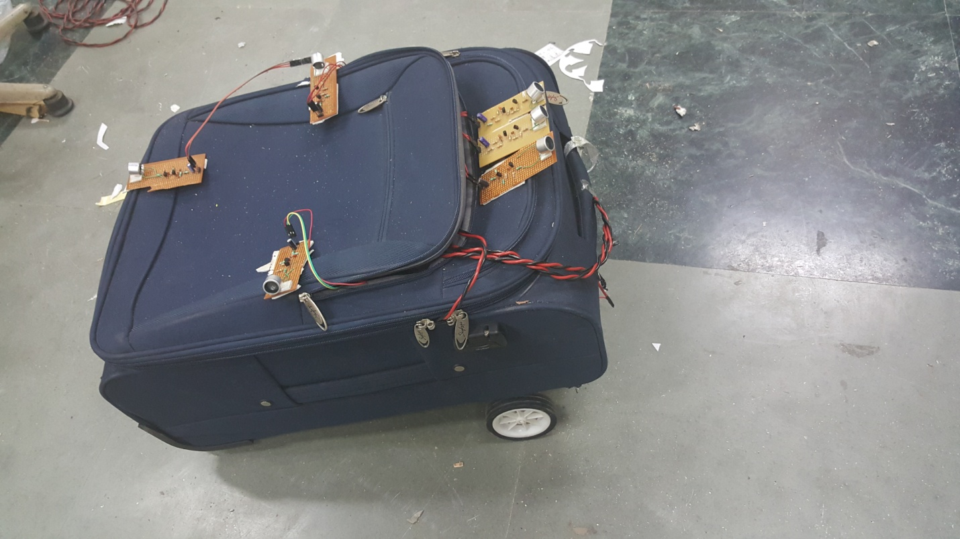
Automatic luggage follower

Slide 2
Luggage follower
The Luggage Follower- The purpose of the project was to create a device that was capable of assisting travelers with their luggage as they go through an airport. The device was capable of following a single target and avoiding obstacles using Ultrasonic sensors. This project was very similar to our idea for device, in that it had the same basic functionality of carrying around a load for a specific user and following said user around.
Basic Aim: To create a device which works as a luggage follower and it has been implemented on the suitcase with 6 Ultrasonic receiver circuit around the suitcase along with the wheels which basically tracks the the single transmitter carried by the user.

Slide 3
Motivation
Year back, I was suffering from back pain and one day I was travelling to Delhi and I was unable to lift the luggage because of my back pain. That day I decided to make a device which could really help us in lifting the luggage or carrying the luggage which could release my stress and also of others which are suffering with the same problem. So I researched on this topic and after many weeks, I found the solution. We started working on the project step by step .

Slide 4
Components of the device:
1.Ultrasonic Sensors-Ultrasonic sensors use sound to accurately detect objects and measure distances. These sensors provide outstanding background suppression to reliably detect objects, regardless of the object’s appearance. The output used – switching, analog or both – is determined based on your application requirements.
2. IC 7805-7805 is a voltage regulator integrated circuit. The voltage source in a circuit may have fluctuations and would not give the fixed voltage output. The voltage regulator IC maintains the output voltage at a constant value. 7805 provides +5V regulated power supply. Capacitors of suitable values can be connected at input and output pins depending upon the respective voltage levels.

Slide 5
3. Arduino- The Arduino Uno is a microcontroller board based on the ATmega328. It has 14 digital input/output pins (of which 6 can be used as PWM outputs), 6 analog inputs, a 16 MHz ceramic resonator, a USB connection, a power jack, an ICSP header, and a reset button. It contains everything needed to support the microcontroller; simply connect it to a computer with a USB cable or power it with an AC-to-DC adapter or battery to get started.
4. IR Sensor- An Infrared (IR) sensor is used to detect obstacles in front of the robot or to differentiate between colors depending on the configuration of the sensor. The circuit required to make an IR sensor consists of two parts; the emitter circuit and the receiver circuit. The emitter is simply an IR LED (Light Emitting Diode) and the detector is simply an IR photodiode which is sensitive to IR light of the same wavelength as that emitted by the IR LED. When IR light falls on the photodiode, its resistance and correspondingly, its output voltage, change in proportion to the magnitude of the IR light received.

Slide 6
5. Wheels and Motor- When deciding on what type of locomotion for device we looked at continuous tracks, six-wheel, and four-wheel. Continuous track also known as caterpillar tracks, or tank treads, are a track had of either steel, rubber, or a combination of steel and rubber, rotated by a series of sprockets. The continuous tracks turned out to be a better option than tires through rough terrain and can glide over small obstacles and small gaps in the ground, and are less likely to get stuck in mud. However they lack in speed and maneuverability compared to tires and they are harder to maintain, as the loss of a single segment of track immobilizes the entire vehicle. Additionally, the tracks has the potential to slip off their sprockets and jam, which in worst case scenario, the track would need to be broken before the jam can be fixed.

Slide 7
Different stages
Stage 1 - In this, we have made our transmitter and receiver circuitry on the pcb.
Stage 2 - In this, we have implemented this circuit on the robot with the help of 2 ultrasonic sensors.
Stage 3 - In this ,we have implemented this circuit on the robot with the help of 6 ultrasonic sensors.
Stage 4 – In the final stage, we have implemented this circuit on the suitcase and finalize the project.

Slide 8
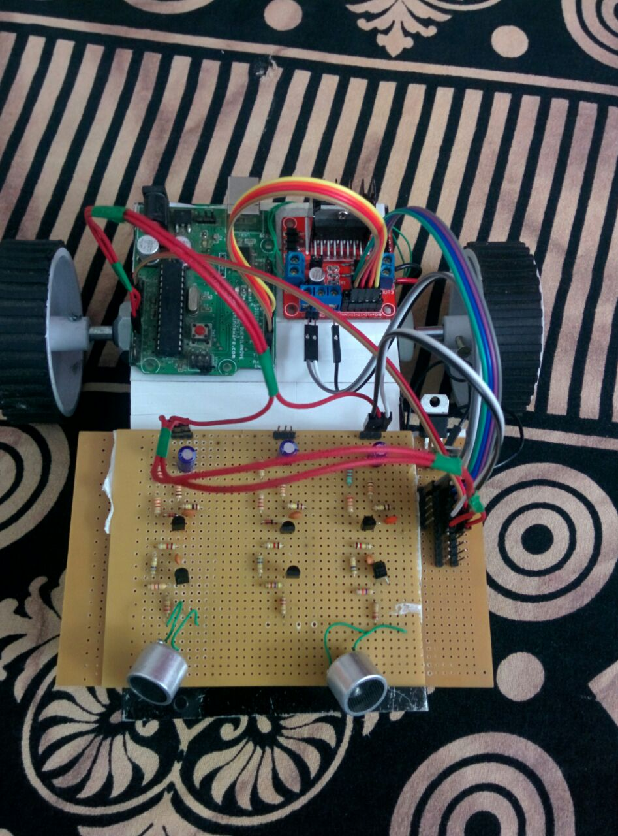
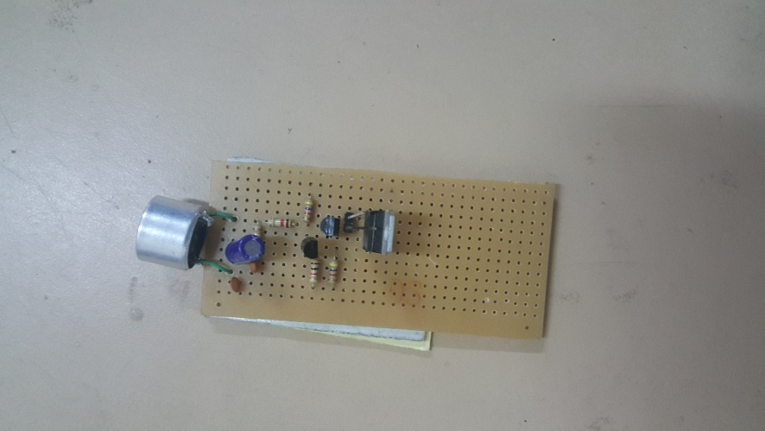
Transmitter circuit implemented Receiver Circuit implemented in stage 1. in stage 2.

Slide 9
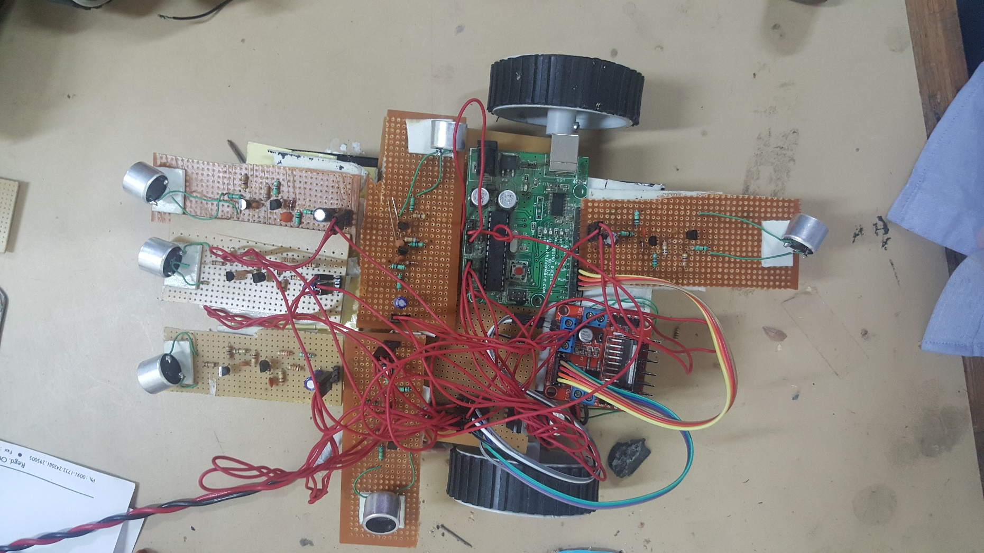
Receiver’s circuit with 6 Ultrasonic Sensors in stage 3.

Slide 10
Final Luggage Follower project with 6 Ultrasonic Sensors and IR sensor

Slide 11
ADVANTAGES OF LUGGAGE FOLLOWER
Portable- One of the main advantages of the device is its small size and portability. It can be easily carried around without any difficulty. The prototype of the device is deigned in such a way that it gives more importance to the portability factor. All the devices are light in weight and can easily be fit into the user’s pocket.
Cost effective-The cost incurred for the construction of the device is quiet low. It was made from parts collected together from common devices. The device have not been made in large scale commercial purpose. Once that happens it’s almost certain that the device will cost much lower than the current price.
It generally enables the user to carry the without any difficulty or we can say that the luggage will follow the user and user need not to track it along with him rather the luggage will follow the user without any obstacle in it and it also includes buzzer system in it which will be activated due to threat.

Slide 12
It is also used in the movement of a blind person through wheelchair. A wheelchair bound person requires the freedom of upper limb body movement to move around. Any attachment to the wheelchair in the form of luggage will enable the blind person to move freely. Another major application of this project is it can even be used in cradle for the small babies.
It can be implemented in industrial machines like for shifting the small heavy machines which cannot be lifted easily and which has wheels attached in it.

Slide 13
THE END

